Slide 1
Analyzing Big Data with SparkR
MSCI:6110 Fall 2019
Master’s in Business Analytics

Slide 2
Clustering (K-Means)
What is clustering?
Grouping data entries based on similarity
Intra-cluster similarity is minimized
Inter-cluster similarity is maximized
Unsupervised learning
There is no ground truth
Used in data exploration
Inter-cluster distances are maximized
Intra-cluster distances are minimized

Slide 3
Use cases
Topic Modeling: given a set of articles, group them based on topic
The topics are unknown. Similarity measured based on word frequency
Customer analysis
Based on the behavior of customers, group them into clusters
True group unknown
Id | Gas $ | Grocery $ | Restaurants $
1 | 50 | 120 | 300
2 | 50 | 140 | 320
3 | 30 | 100 | 350
4 | 200 | 400 | 20
5 | 50 | 20 | 10
6 | 200 | 500 | 0

Slide 4
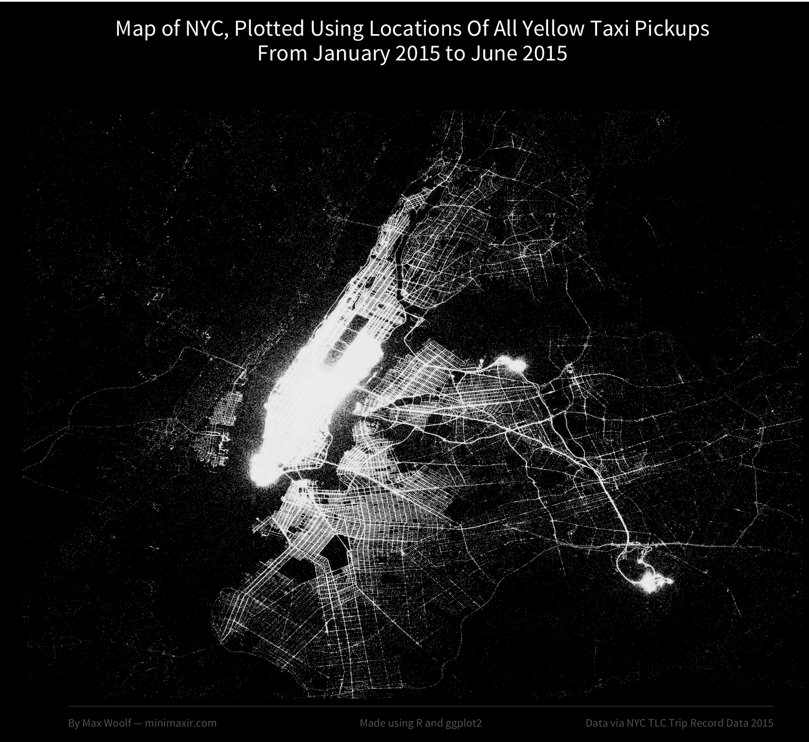
Spatial Clustering
Cluster points in 2-d plane (lat, long) to find patterns
Cluster the pickup locations of taxi trips to find popular regions

Slide 5
How to cluster data?
The input data:
Output:
ID | Attribute 1 | Attribute 2 | …
1 | 100 | 200
2 | 10 | 20
3 | 14 | 18
ID | Attribute 1 | Attribute 2 | … | Cluster #
1 | 100 | 200 |  | 1
2 | 10 | 20 |  | 2
3 | 14 | 18 |  | 2

Slide 6
K-Means Clustering
You need to provide a number K
The method will cluster the data into K groups
What is a centroid: calculate the average of each feature within group

Slide 7
How to cluster data?
The input data:
Output:
ID | Attribute 1 | Attribute 2 | …
1 | 100 | 200
2 | 10 | 20
3 | 14 | 18
ID | Attribute 1 | Attribute 2 | … | Cluster #
1 | 100 | 200 |  | 1
2 | 10 | 20 |  | 2
3 | 14 | 18 |  | 2
Centroid of cluster #2 : 12, 16

Slide 8
Example

Slide 9
K-Means in SparkR
Maximum number of iterations before stop
How to find the initial centroids (usually random)
Function spark.kmeans()
model <- spark.kmeans(data, formula, k = 2, maxIter = 20, initMode = "random")
Although k-means is NOT a predictive model, the function still produces a “model”. You need to use the “Predict” function to generate the clusters
Number of clusters
A spark data frame
Which columns to use for clustering. Target variable is empty

Slide 10
Example
Use the mtcars dataset. Cluster the cars into 4 clusters.
mtcars_df <- as.DataFrame(mtcars)
model <- spark.kmeans(data = mtcars_df, ~ ., k=4, maxIter = 20, initMode = "random")
summary(model)
“ ~ .” means to use all the attributes to do clustering.
Target variable is always empty for clustering

Slide 11
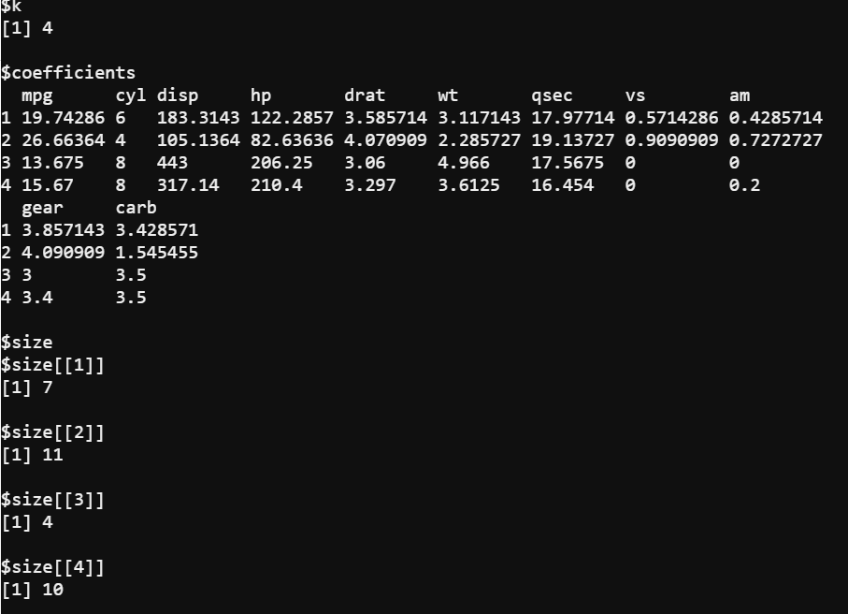
“Model”

Slide 12
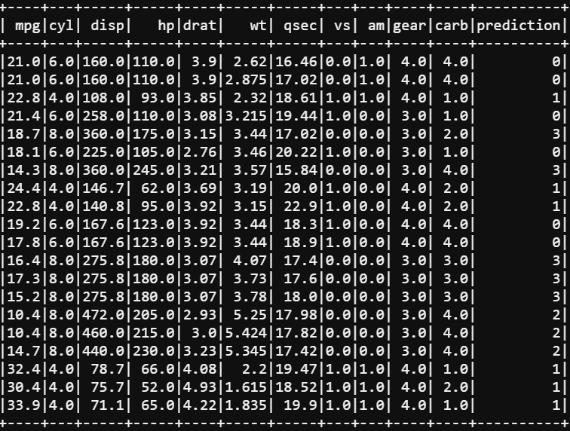
Show the fitted data
mtcars_df_fitted <- predict(model, mtcars_df)
showDF(mtcars_df_fitted, 20)
The “prediction” column is the
Cluster number assigned.

Slide 13
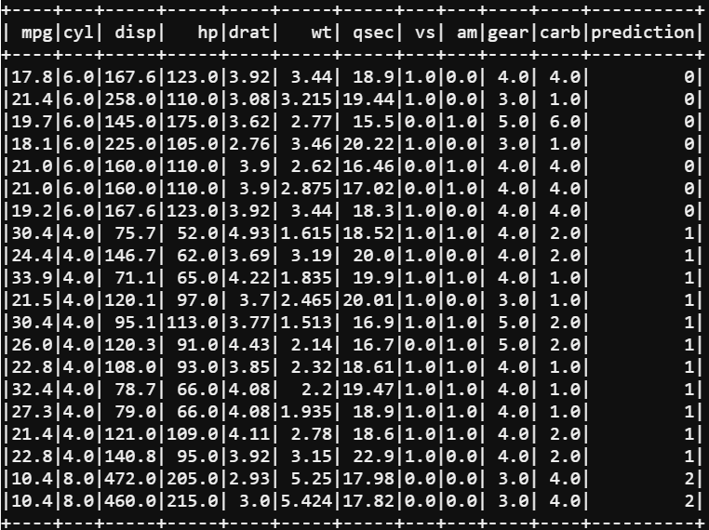
Sort results by cluster number
Use the orderBy function to sort SparkR dataframe
showDF(orderBy(output, output$prediction))
showDF(orderBy(output, -output$prediction))

Slide 14
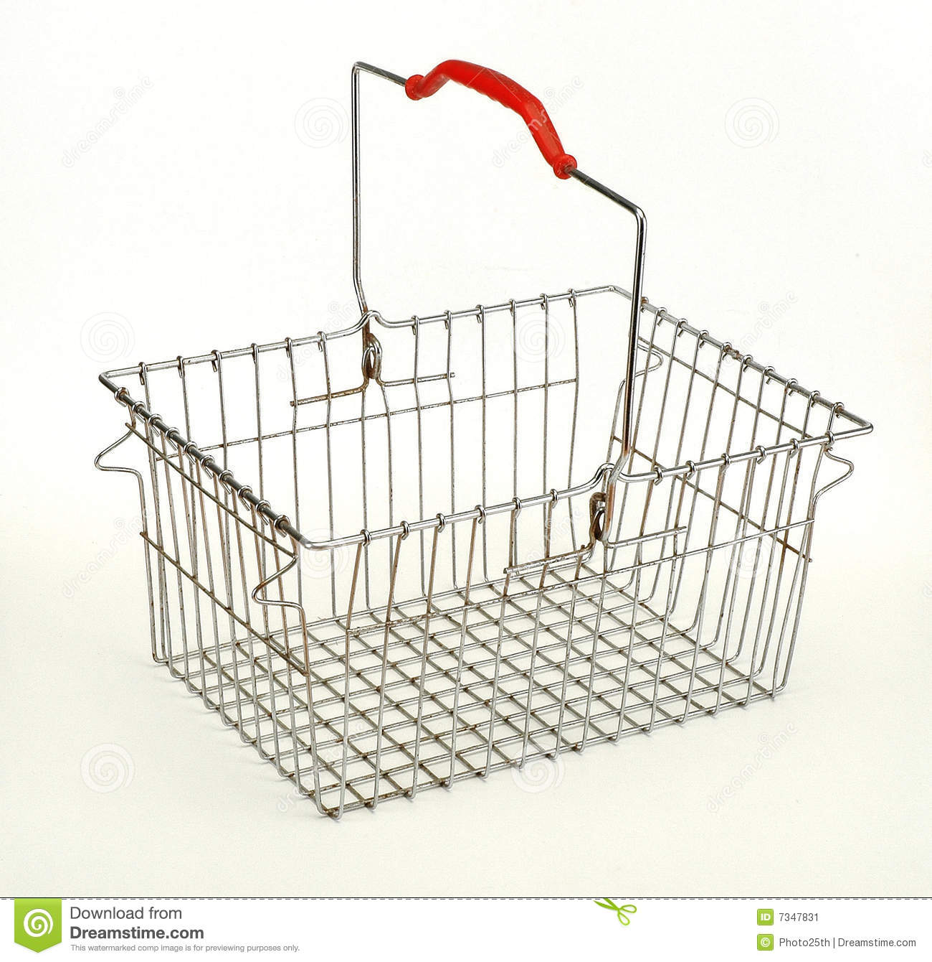
Association Rule Mining
Market Basket Data
Each transaction (receipt) contains a number of items
When you buy A, how likely that you also want to buy B?
Lighter → cigarettes (or revserse?)
Paper plates, plastic forks → napkins
Bread → butter
Some of them are trivial
Finding unknown groups may help improve sales!

Slide 15
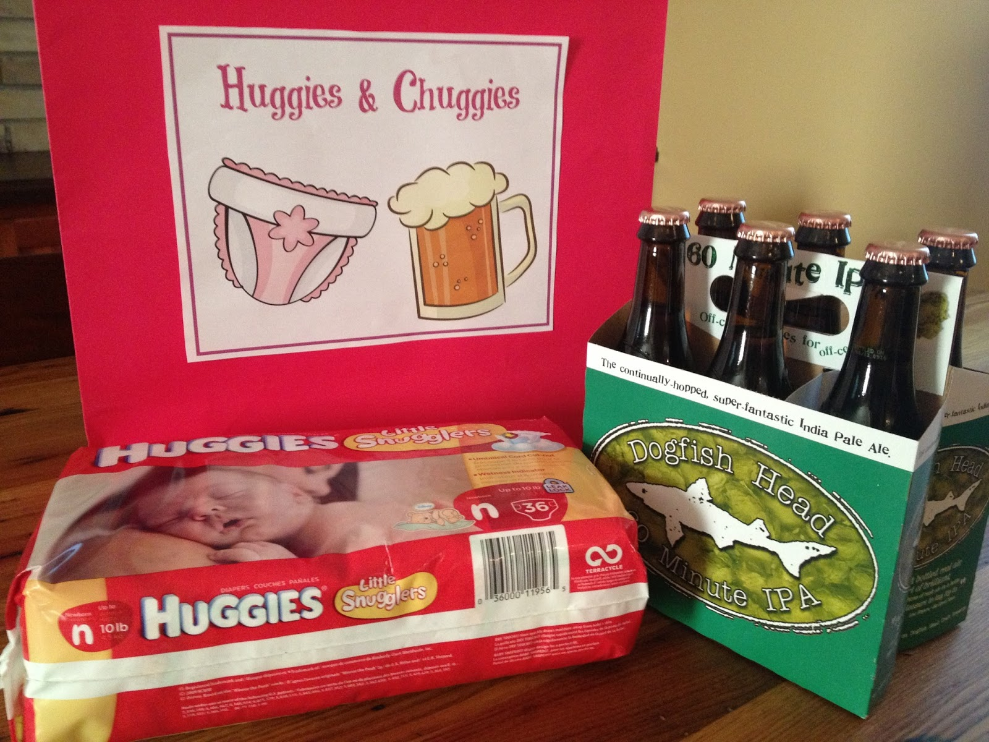
Diaper and Beer

Slide 16
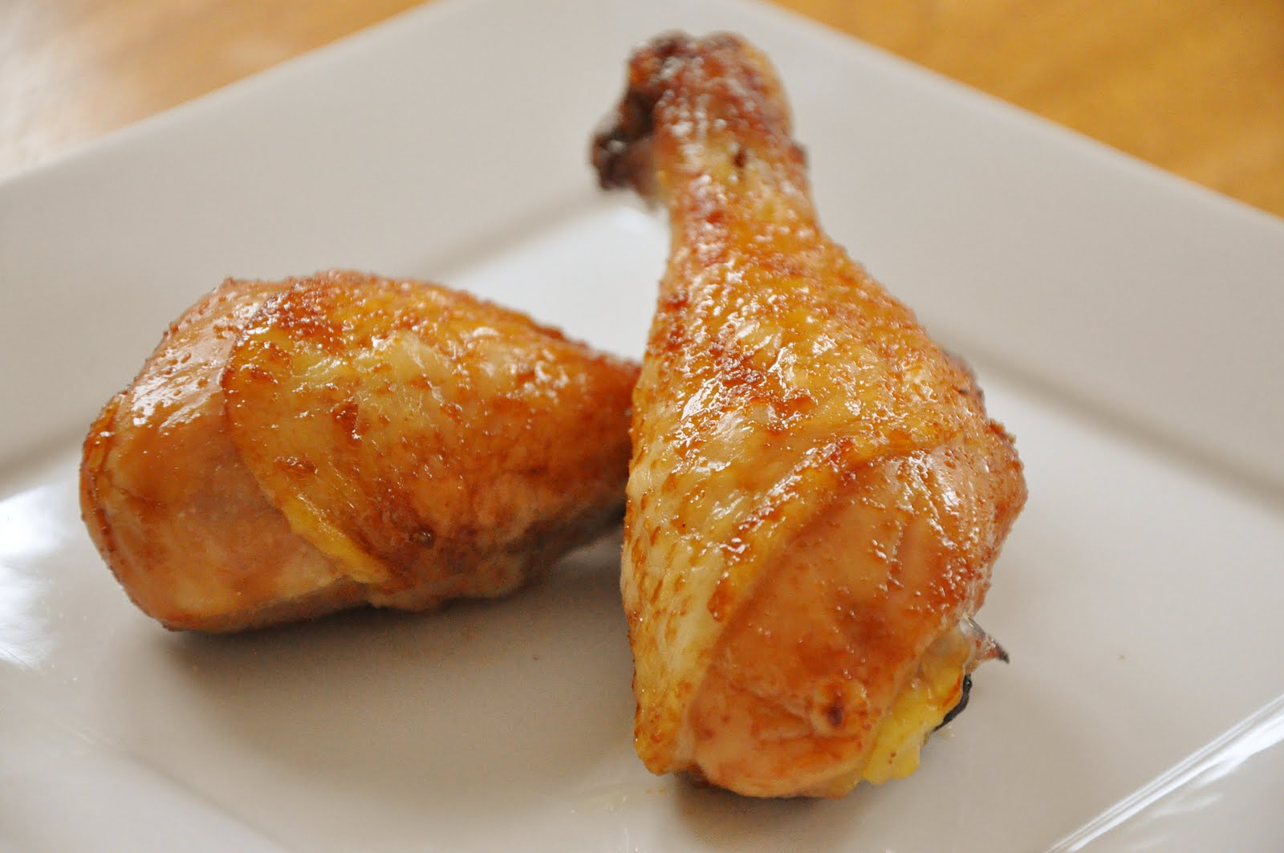
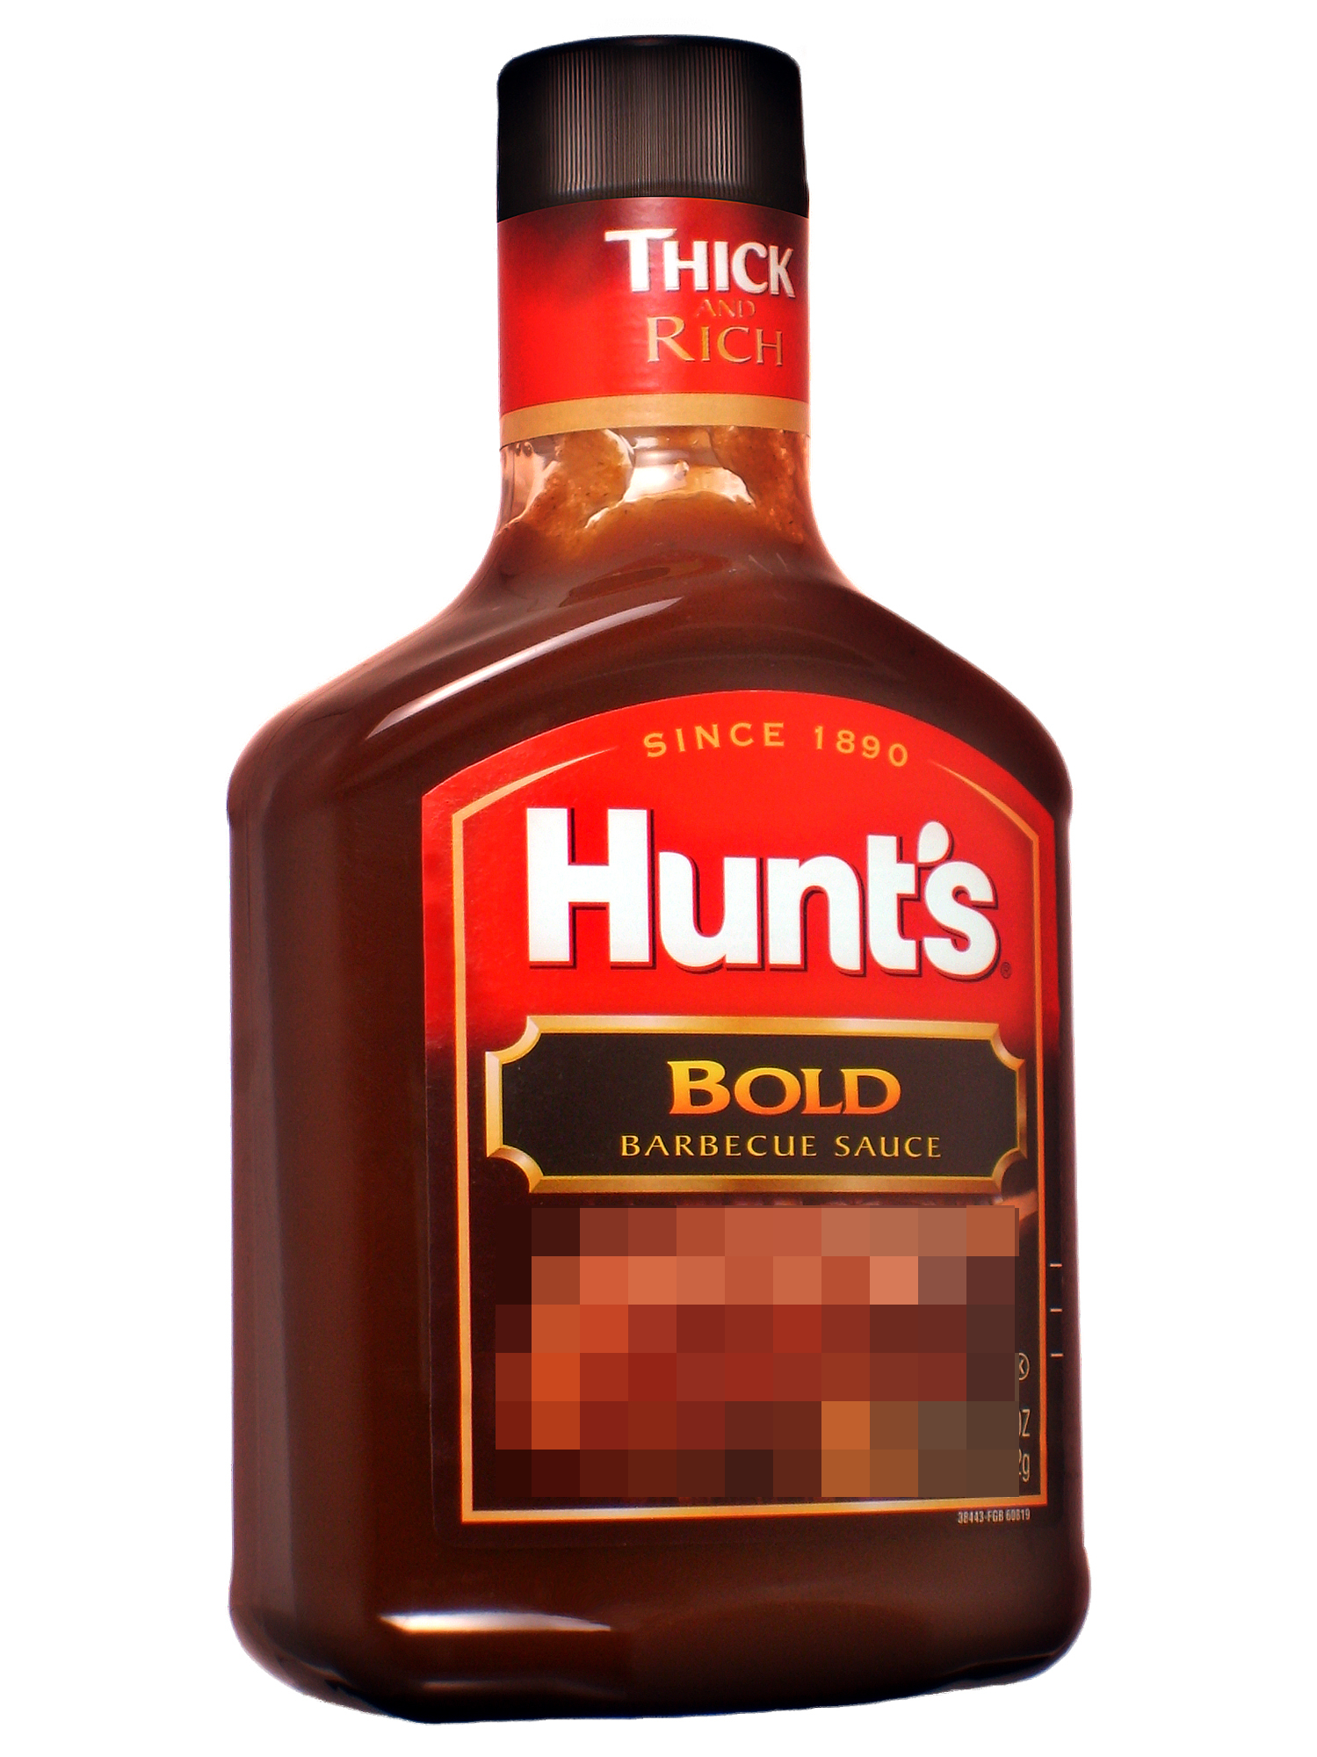
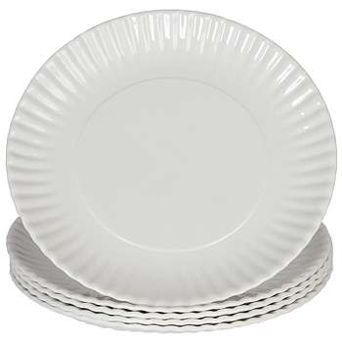
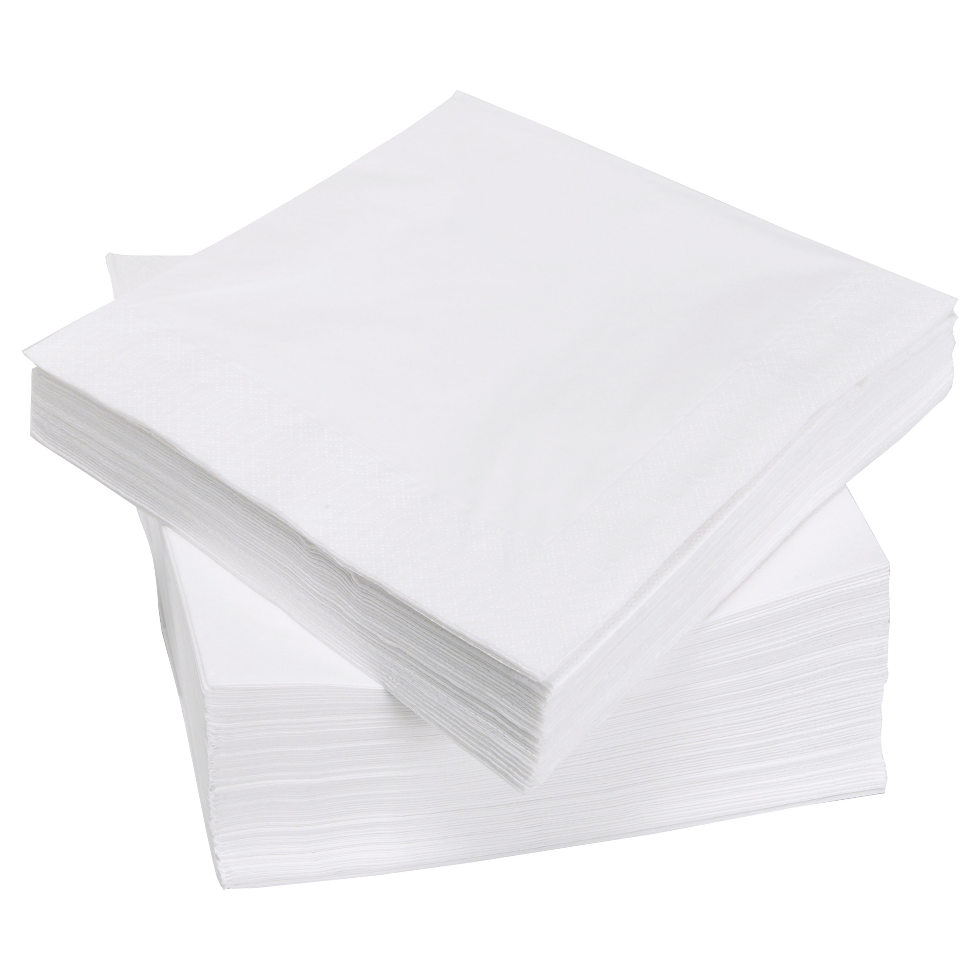

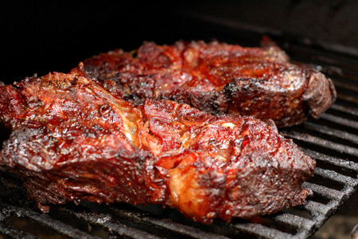
Association Rule Mining
Association Rule {A} → {B}
{A, B} show up together often enough (high “support”)
Association between them is also very strong
Whenever you see {A} in one transaction, it's very likely for you to observe B (high “confidence”)
Example
{Chicken, BBQ Sauce, Paper Plates, Napkins}
{Chicken, BBQ Sauce, Napkins}
{Chicken, Plastic Forks}
{Beef, BBQ Sauce}
{Chicken, BBQ Sauce, Plastic Forks}

Slide 17
Association Rule Mining
Support: The support for an association rule A→B is the ratio/percentage of total transactions (e.g., orders) in the database that contain both A and B.
Confidence: The confidence for an association rule A→B is the number of transactions that contain both A and B as a percentage of the number of transactions that contain A.
Example
{chicken → BBQ sauce}
Support: 60%, confidence: 75%
{BBQ sauce →chicken }
Support: 60%, confidence: 75%
{Napkin → Chicken }
Support: 40%, confidence: 100%
Minimum support: 50%
Minimum confidence: 60%

Slide 18
Association Rule Mining
Association Rule with 3 or more items ({A,B}→C)
{A, B, C} show up together often enough (high “support”)
Whenever you see {A, B} in one transaction, it is very likely that you also observe C (high “confidence”)
Example?
{Chicken, BBQ Sauce} → Napkins
Support: 40%
Confidence: 66.7%

Slide 19
Exercise
Which one of these association rules has a support of at least 50%
and the highest confidence?
Item 3 → Item 5
Item 4 → Item 5
Item 2 → Item 1
Item 5 → Item 3

Slide 20
Association Rule Mining
1. Generate “Frequent Item Sets” with support >= threshold
2. Among these frequent item sets, identify association rules with high confidence.
Step 1 is challenging because the total possible combinations of items is exponentially large. For N items, the number of possible combination is 2^{N} -1
An algorithm called FP-Growth is implemented in R

Slide 21
Data Preparation
A spark Data-frame with one column
Each row is a transaction array
“1,2,3”, “4,5”, “1,4,6”
first, create a R data frame with strings of transactions, then split them
df <- selectExpr(createDataFrame(data.frame(rawItems = c("3,5", "1,2,4", "1,2,5", "1,2,4", "1,2,3,5", "3,5", "", "1,4,5", "1,2", "1,4,5"))), "split(rawItems, ',') AS items")

Slide 22
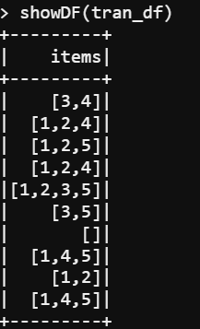
Transactional Data
One column with 1-D spark Array data type
Spark Array: An object, with multiple elements listed.
Elements should have the same data type (e.g., INT)

Slide 23
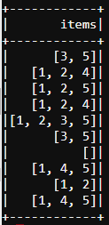
In SparkR 2.2 or later
Then run the FP-growth function
Give the DataFrame, column, and thresholds (support, confidence)
fpm <- spark.fpGrowth(df, itemsCol="items", minSupport=0.3, minConfidence=0.5)
spark.freqItemsets(fpm) ## Check the frequent item set generated from the data
spark.associationRules(fpm) ## Check the association rules generated from the data
predict(fpm, df) ## Given a data frame, predict if anything else would be associated with each transaction

Slide 24
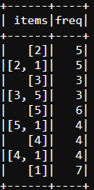
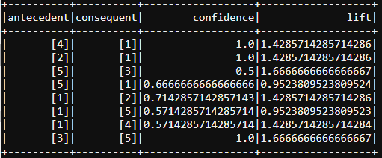
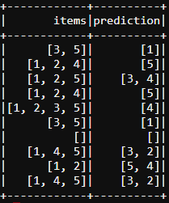
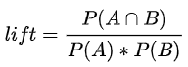
Output
1. Frequent item sets 2. Association rules 3. Predictions
For rule A-> B , we can use “lift” to evaluate if it is useful (lift always > 1)
Lift = Supp(A, B)/(Supp(A)*Supp(B)).
Lift = (4->1) = (4/10)/(4/10*7/10) = 10/7 = 1.42857
Larger lift suggests stronger association. Lift = 1 means no association (independent).

Slide 25
What if the items are in different rows?
df
OrderID | ItemID | Quantity
1001 | A | 2
1001 | B | 1
1002 | A | 1
1003 | B | 3
1003 | C | 1
1004 | A | 1
1004 | B | 1
1004 | C | 2
Pull the data into a spark DataFrame
We need to Group the data by OrderID and
aggregate all the ItemID into one array for each order
Use the collect_set() function
Use DataFrame Manipulation Function
agg(groupBy(df, df$OrderID), ItemID = “collect_set”)

Slide 26
What if the items are in different rows?
Pull the data into a spark DataFrame
We need to Group the data by OrderID and
aggregate all the ItemID into one array for each order
Use the collect_set() function
Use DataFrame Manipulation Function
df_agg <- agg(groupBy(df, df$OrderID), ItemID = “collect_set”)
colname(df_agg)[2] <- “Items”
OrderID | Items
1001 | [A, B]
1002 | [A]
1003 | [B, C]
1004 | [A, B, C]

